Slide 1
Research Process
Part-II

Slide 2
Till now
We have discussed the first two steps:
Formulation/identification of research problem
Review of the literature

Slide 3
Step3: Specifying purpose of research
or Formulating the objectives
Objectives are the goals/aims you set out to attain in your study.
They inform a reader what you want to attain through the study.
It is extremely important to word them clearly and specifically.
The main objective/aim is an overall statement of the thrust of your study.
It is also a statement of the main associations and relationships that you seek to discover or establish.
The sub-objectives are the specific aspects of the topic that you want to investigate within the main framework of your study.
They should be numerically listed.
Wording should clearly, completely and specifically communicate to your readers your intention.
Each objective should contain only one aspect of the study.
Use action oriented words or verbs when writing objectives.
The objectives should start with words such as ‘to determine’, ‘to find out’, ‘to ascertain’, ‘to measure’, ‘to explore’, ‘to investigate’ etc.
Clear +Complete +Specific + Identify main variables to be correlated + Identify the direction of relationship
This step is also known as formulation of research questions

Slide 4
Step4: Formulating hypotheses
Hypothesis is tentative assumption made in order to draw out and test its logical or empirical consequences.
“the information needs of researchers are different from those of practitioners.”
Mouly considers a hypothesis to be “a tentative generalization concerning the relationship between two or more variables of critical interest in the solution of a problem under investigation.”
Webster, defines a hypothesis as “a proposition, condition, or principle, which is assumed, perhaps without belief, in order to draw out its logical consequences and by this method to test its accord with facts which are known or may be determined.”

Slide 5
Research Hypothesis should be very specific and limited to the piece of research in hand because it has to be tested.
The formulation of hypothesis provides a study with focus. It tells you what specific aspects of a research problem to investigate.
A hypothesis tells you what data to collect and what not to collect, thereby providing focus to the study.
As it provides a focus, the construction of a hypothesis enhances objectivity in a study.
A hypothesis may enable you to add to the formulation of a theory. It enables you to specifically conclude what is true or what is false.

Slide 6
Types of hypotheses
Working or research hypothesis—the hypothesis with which a research study begins. It should help to delimit and guide the study.
Final hypothesis—the hypothesis that reflects the findings of the research study. It often is synonymous with the study’s final conclusion.
Particular hypothesis—a hypothesis which merely explains a specific fact or situation; for example, “not all college students are skilled library users.”
Causal hypothesis—a hypothesis which states that there is a causal relationship between two or more variables (i.e., that a particular factor or condition determines or affects another factor or condition).
Statistical Hypothesis:
Null hypothesis—asserts that there is no real relationship between or among the variables in question. It involves the supposition that chance, rather than an identifiable cause, has produced some observed result. It is used primarily for purposes of statistical testing.
Alternative hypothesis—provides another possible and plausible solution to the problem (i.e., a different explanation of the same facts).

Slide 7
Types of hypotheses
Inductive hypothesis—a hypothesis which moves from the particular to the general, or a generalization based on observation.
Deductive hypothesis—a hypothesis which shifts from the general to the particular, or a hypothesis derived from a theory.
Nondirectional hypothesis—a hypothesis which merely indicates that a relationship or difference exists. It says nothing about the nature or direction of the relationship. For example, one might hypothesize that a student’s grade point average and use of libraries are related without going so far as to argue that either factor causes the other.
Directional hypothesis—a hypothesis which indicates the nature of the relationship between or among variables. For example, it could logically be hypothesized that the assignment of term papers results in more library use by certain students.
Multivariate hypothesis—a hypothesis proposing a relationship among more than two phenomena or variables.
Bivariate hypothesis—a hypothesis proposing a relationship between two phenomena or variables.
Univariate hypothesis—a hypothesis concerned with only one phenomenon or variable. In that no relationship is involved, one could argue that this kind of statement does not meet the minimal criteria for a hypothesis. It might better be termed a research question.

Slide 8
How to develop working hypotheses
Discussions with colleagues and experts about the problem, its origin and the objectives in seeking a solution;
Examination of data and records, if available, concerning the problem for possible trends, peculiarities and other clues;
Review of similar studies in the area or of the studies on similar problems; and
Pilot study or Exploratory personal investigation which involves original field interviews on a limited scale with interested parties and individuals with a view to secure greater insight into the practical aspects of the problem.

Slide 9
Process of framing hypotheses
Hypothesis always relies on some assumptions.
Find out the basic assumption or assumptions to form a premise.
Ex: a hypothesis which predicts that older people are less likely to use information technology than are younger people.
Might be partially explained by the assumption that older people have more anxiety regarding the use of technology.
Develop additional explanations of relationships between or among the variables in speciﬁc situations.
These additional explanations constitute, in effect, alternative hypotheses.
The most viable hypothesis must then be identiﬁed by evaluating the various alternative hypotheses and eliminating the less effective ones.
Law of parsimony can be followed: which dictates selecting the simplest explanation or hypothesis and the one requiring the fewest assumptions.

Slide 10
Desirable Characteristics of Hypotheses
Generalizability, or universality - hold up true in more than one situation
Compatibility with existing knowledge – based on earlier studies
Testability – empirically testable
Invariability – over time
Causality or correlation- states a relationship that is causal in nature or correlational

Slide 11
Operationalisation
Variables - “any property of a person, thing, event, setting, and so on that is not ﬁxed.”
Independent variables - This is the variable that determines, inﬂuences, or produces the change in the other main factor
Dependent variables – or subject variable This variable is dependent on or inﬂuenced by the independent variable(s).
Intervening variable - any variable which occurs in the causal chain between some independent variable and its dependent variable.
Extraneous variable - inﬂuences both theindependent and the dependent variables so as to create a spurious association between them.
Confounding or interfering variable - another inﬂuence that may affect the dependent variable but one in which the researcher is not interested.

Slide 12
Activity
A study of the relationship of role conﬂict, the need for role clarity, and job satisfaction for professional librarians.
Library design inﬂuences on user behavior and satisfaction.
An investigation of the relationships between quantiﬁable reference service variables and reference performance in public libraries.
The impact of differing orientations of librarians on the process of children’s book selection: a case study of library tensions.
Book selection and book collection usage in academic libraries.
The effect of prime display location on public library circulation of selected adult titles.
Implications of title diversity and collection overlap for interlibrary loan among secondary schools.
The attitudes of adults toward the public library and their relationships to library use.
Early libraries in Louisiana: a study of the Creole inﬂuence.
The Great Depression: its impact on 46 large American public libraries; an inquiry based on a content analysis of published writings of their directors.

Slide 13
Title number 1: independent variable—role conﬂict, dependent variables—need for role clarity and job satisfaction;
title number 2: independent variable— library design, dependent variables—user behavior and satisfaction;
Title number 3: independent variable—quantiﬁable reference service variables, dependent variable—reference performance;
title number 4: independent variable—differing orientations of librarians, dependent variable—process of children’s book selection;
title number 5: independent variable—book selection, dependent variable—book collection usage; title number 6: independent
variable—prime display location, dependent variable—circulation of selected adult titles,
title number 7: independent variables—title diversity and collection overlap, dependent variable—interlibrary loan among secondary schools;
Title number 8: independent variable—attitudes of adults toward the public library, dependent variable—library use; title number 9: independent variable—Creole inﬂuence, dependent variable—early libraries in Louisiana;
title number 10: independent variable—Great Depression, dependent variable—large American public libraries.

Slide 14
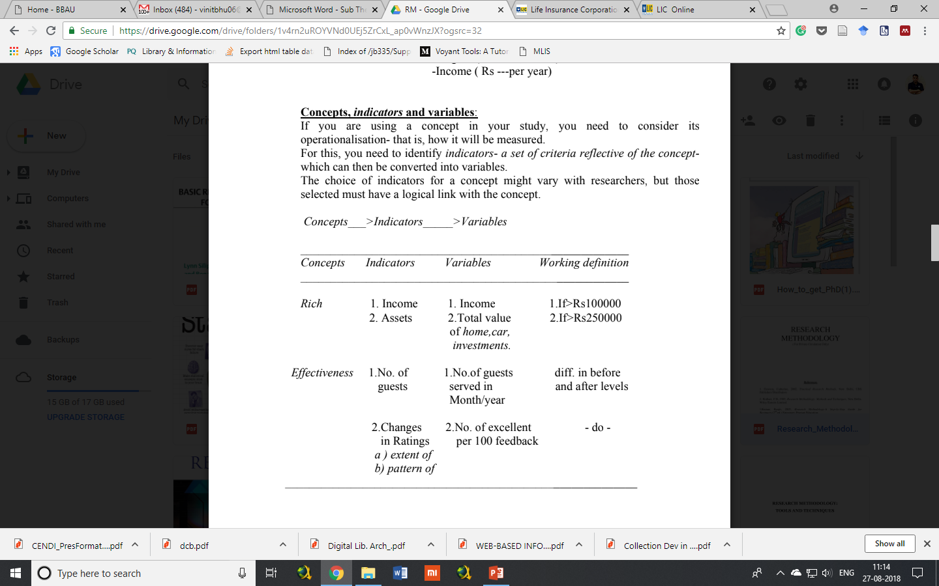
Concepts
If there are concepts in the study, one has to perform the operationalisation.
To do so, one has to first find out the indicators – a set of criteria reflective of the concept which can then be converted into variables.
Concept >> Indicators >> Variables

